Slide 1

Why Do Companies Need QA?

Slide 2
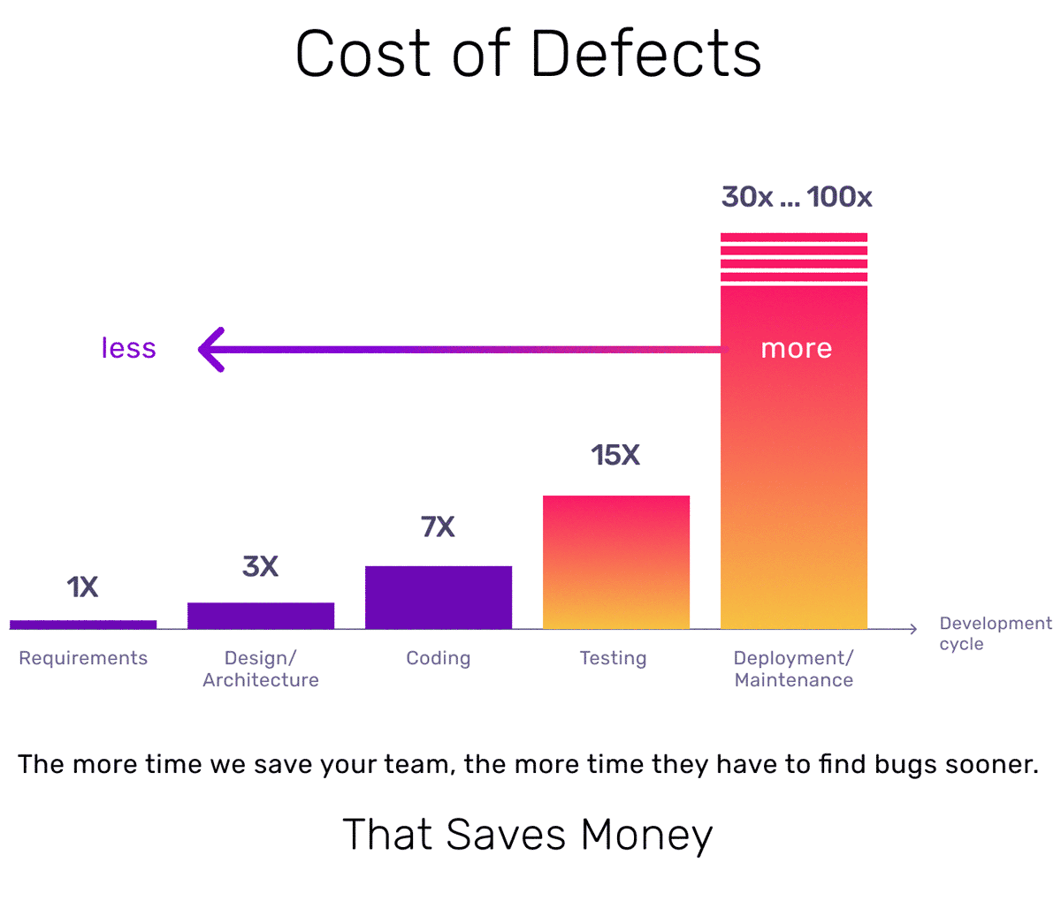
A production bug can cost a company millions and damage its reputation
A good QA process helps identify and fix these issues before they impact users.
💰 Real Examples:
Amazon: A bug in 2017 caused an S3 outage, impacting thousands of businesses. → Estimated loss: $150M
Knight Capital Group: A software error cost $440M in 45 minutes.

Slide 3

The QA: A Key Player in the Team
✅ QA does not work alone! It collaborates with: 👨‍💻 Developers → Helps prevent bugs from the design phase. 🎨 Designers → Ensures the user experience is consistent. 📋 Product Owners/PM → Ensures that functionalities align with business needs. 🎯 Clients/Stakeholders → Provides reports and assists in decision-making.
✅ Integration Methods Based on the Team:
In Agile Mode (Scrum, Kanban) → Participates in daily meetings, refines tickets early, and tests continuously.
In V-Model / Waterfall Approach → Prepares comprehensive test plans upfront and conducts final-stage testing.
✅ Why QA should not be seen as a "roadblock"? 📌 "QA does not criticize; it secures!"
It prevents risks before they reach production.
It does more than just report bugs; it also suggests improvements (performance, accessibility, ergonomics...).
It helps avoid conflicts by providing objective facts (logs, reproducible tests...).

Slide 4
How to Properly Integrate a QA into a Team?
✅ From the Design Phase → Include QA in product discussions and specifications. ✅ Daily Collaboration → Participate in meetings to identify risks early. ✅ Alignment with Developers → Define clear acceptance criteria. ✅ Transparency with Stakeholders → Explain priorities and test coverage.
⚠️ Common Challenges Faced by QA:
❌ QA arrives too late → It is only integrated at the end, in "Test & Fix" mode. ❌ Resistance from developers → "This bug doesn’t exist on my machine!" ❌ Testing is not a priority → Time-to-market takes precedence over quality. ❌ Lack of appropriate tools → Reporting is requested without providing solutions.
✅ Solution: Educate the team on the importance of QA and focus on prevention rather than correction.

Slide 5
What is (wrongly) expected from QA
❌ "QA guarantees that there will be NO bugs in production" → QA reduces risks but cannot test everything. ❌ "QA is responsible for defects that make it to production" → Undetected defects are often due to a lack of time, resources, or coverage. ❌ "QA slows down the project with too much testing" → Testing anticipates costly problems. ❌ "QA must test everything manually" → Automation and exploratory testing complement each other.
What QA actually does: ✅ Prioritizes tests based on risk → We don’t test everything, we test smartly. ✅ Identifies inconsistencies from the design phase → Challenges tickets even before development starts. ✅ Facilitates communication between dev, PO, and business → Translates technical risks into business issues. ✅ Adapts to project constraints → Uses existing tools rather than imposing a new workflow.

Slide 6
Why QA is an Investment, Not a Cost?
🔹 90% of production incidents are caused by untested changes (Source: IBM Systems Science). 🔹 A bug detected in production costs up to 100x more than one fixed during the design phase (Source: Capers Jones). 🔹 Companies that invest in QA reduce software maintenance costs by 40%.
🚀 The Direct Benefits of QA: ✅ Reduction of maintenance costs → Fewer fixes required after deployment. ✅ Improved customer satisfaction → Fewer regressions = better user experience. ✅ Time savings for developers → Less rework and fewer urgent fixes. ✅ Faster time-to-market → Fewer production incidents = smoother deliveries.

Slide 7

QA Strengthens Customer and User Trust
🔹 88% of users do not return to a site after a bad experience (Source: Gomez Report). 🔹 A single critical bug can cause up to 30% of potential customers to leave (Source: IEEE). 🔹 Companies that invest in QA *improve customer retention by 20 to 30%.
🔍 How does QA directly impact user experience?
✔ Fewer bugs = higher customer satisfaction → A reliable application reassures users. ✔ Usability & accessibility testing → An easy-to-use product reduces frustration. ✔ Performance and speed → A slow or unstable site drives users away. ✔ Service reliability → A crash during a transaction can cause a customer to leave forever.

Slide 8

QA: A Sustainable Investment for the Future
🔮 Why is QA essential for the future?
✅ Anticipating technological advancements → Adapting to new architectures, AI, and microservices. ✅ Enhanced security → Preventing cyberattacks through rigorous testing. ✅ Optimized user experience → More intuitive and high-performing products. ✅ Reduction of technical debt → Less costly maintenance and greater flexibility.

